Slide 1
Similarity and Nearest Neighbors
Dave Eargle – CU Boulder

Slide 2
1. Similarity

Slide 3
Similarity in practice
How might a company find potential customers that are “similar” to their best current customers?
Say an online advertiser has a list of its “good” customers – those who have responded to ads in the past. How might the advertiser decide how “similar” a prospective customer is to their “good” customers?
How do Amazon or Netflix decide which products or movies are most “similar” to ones you have already purchased or watched?
How might an algorithm do the following?
Doctors recall “similar” cases to help them reason about new ones
Lawyers rely on “similar” cases (legal precedent) in making their arguments
Notes:
For Amazon or Netflix – they can either look at similarity between product-product pairs, people-people pairs, or potentially even product-people pairs

Slide 4
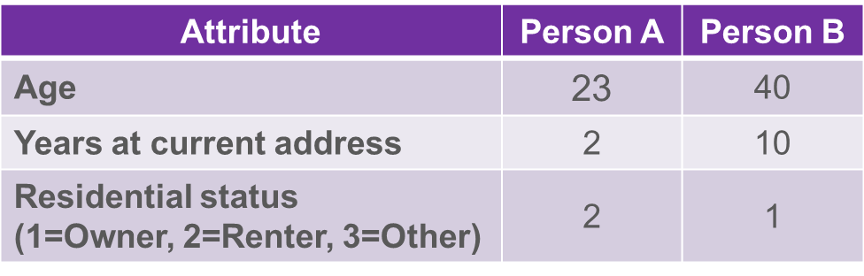
Similarity requires numeric representation of properties of objects
Say you have two people, and you know the “Age”, “Years at current address”, and “residential status” for both of them.
How might you represent with just one number the “similarity” of these two people?
Somehow, encode all categoricals as numbers.

Slide 5
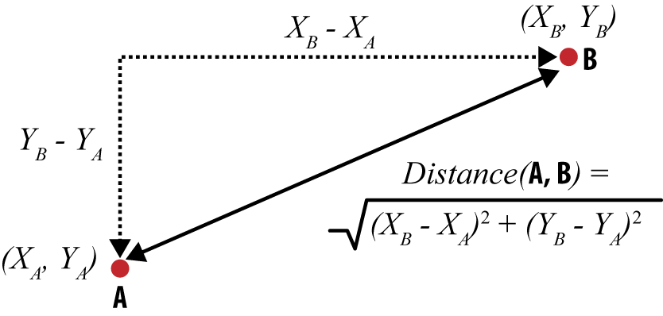
What is the distance between these two points?

Slide 6
Euclidean Distance (just one way to calculate distance)
What if you had more than two dimensions?

Slide 7

Euclidean Distance with more than two dimensions…
$$\sqrt{{\left(d_{1,A}−d_{1,B}\right)}^{2}+{\left(d_{2,A}−d_{2,B}\right)}^{2}+…+{\left(d_{n,A}−d_{n,B}\right)}^{2}}$$
So, with the example data from a few slides ago with three dimensions:
$$d\left(A,B\right)=\sqrt{{\left(23−40\right)}^{2}+{\left(2−10\right)}^{2}+{\left(2−1\right)}^{2}}=18.8$$
How would we do it?

Slide 8
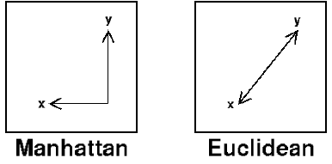
How else might you represent the distance between these two points?
Called “Manhattan” because it’s “how many city blocks would you have to drive…”
$$d_{Manhattan}\left(X,Y\right)={\left\|X−Y\right\|}_{1}=\left|x_{1}−y_{1}\right|+\left|x_{2}−y_{2}\right|+…$$

Slide 9
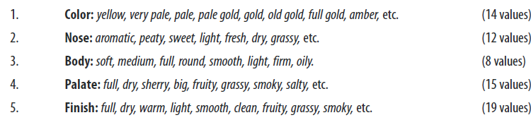
Example: “Whiskey Analytics”
Some guys obsessed with Whiskey wasted a bunch of time scoring all possible whiskeys by five properties:
Color
Nose
Body
Palate
Finish
Where each property can have one (or several!) of different values…
Given a whisky, how might you find other “similar” whiskeys?

Slide 10
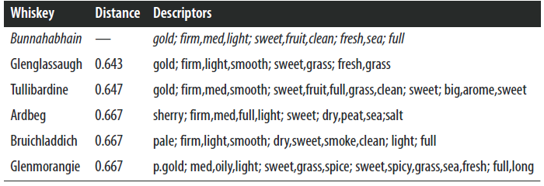
Example: “Whiskey Analytics”
For example, here’s whiskeys that are similar to “Bunnahabhain” (seriously who comes up with these names)
… but where do these “distance” scores come from? Aren’t these text attributes?

Slide 11
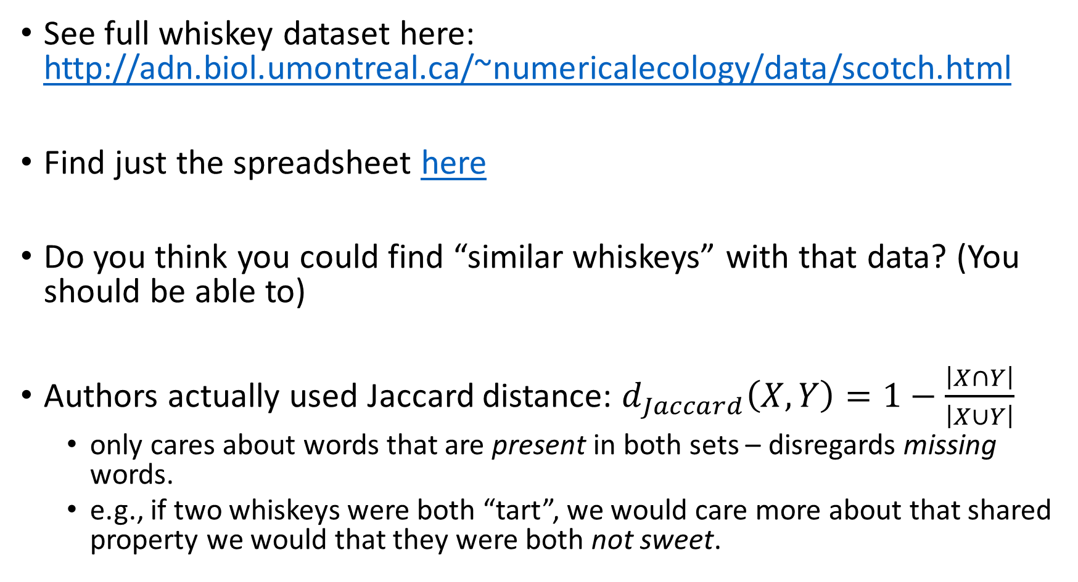
Answer: dummy-code all possible values
See full whiskey dataset here: http://adn.biol.umontreal.ca/~numericalecology/data/scotch.html
Find just the spreadsheet here
Do you think you could find “similar whiskeys” with that data? (You should be able to)
Authors actually used Jaccard distance: $d_{Jaccard}\left(X,Y\right)=1−\frac{\left|X∩Y\right|}{\left|X∪Y\right|}$
only cares about words that are present in both sets – disregards missing words.
e.g., if two whiskeys were both “tart”, we would care more about that shared property we would that they were both not sweet.

Slide 12
Jaccard Distance is great for comparing binary features between A and B when…
… A and B both have 0’s for a lot of those binary attributes …
… and for when you don’t care when neither has an attribute…
… when you care more about attributes that at least one of them has
https://en.wikipedia.org/wiki/Jaccard_index#Difference_with_the_simple_matching_coefficient_(SMC)

Slide 13
2. Nearest Neighbors

Slide 14
How might you use similarity for predictive modeling?
Hint: this process is called “Nearest Neighbors”. How might it work?

Slide 15
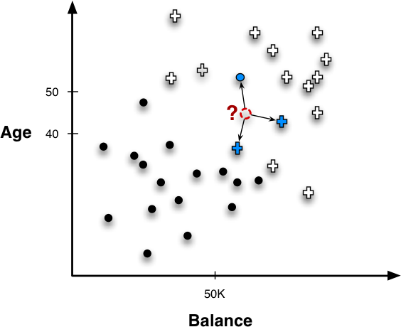
Nearest Neighbors for Predictive Modeling
Say we have a point right here. We decide to consult the three closest neighbors. How should we classify this point?
What “probability” of `+` would we assign for this point, given its three closest neighbors?

Slide 16
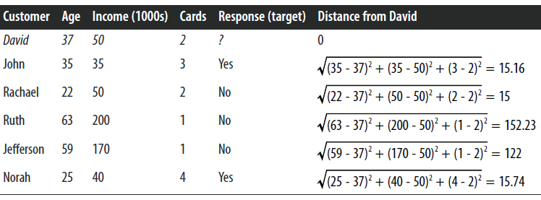
Nearest Neighbors for Predictive Modeling

Slide 17
Nearest Neighbors for Predictive Modeling
How will we classify David if we choose the three nearest neighbors?

Slide 18
How many neighbors and how much influence?

Slide 19

How many neighbors and how much influence?
Yes: 2
No: 3
Therefore, classify as “no”
What if we have chosen to compare against the 5 nearest neighbors. What would the classification have been then?

Slide 20
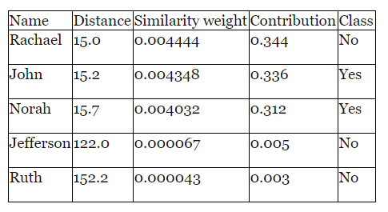
Fix that! How might we give “closer” neighbors more “influence” on the prediction?
Similarity weight divided by sum of all similarity weights
Squared inverse of distance
Probability “No” = sum of “no” contributions
p_no = 0.35
Probability “Yes” = sum of “Yes” contributions
p_yes = 0.65

Slide 21
How can we make them have the same impact?
Should the difference between “1” and “2” cards have the same impact as the difference between a 38- and a 39-year old?

Slide 22
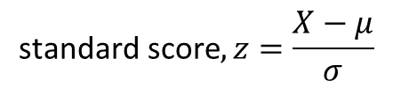
Scaling
$$\text{standard} \text{score}, z=\frac{X−μ}{σ}$$
Age | age-z-score
37 | -0.20212
35 | -0.32977
22 | -1.15951
63 | 1.457364
59 | 1.20206
25 | -0.96803
age-average | age-std-dev
40.16667 | 15.66755
Cards | cards-z-score
2 | -0.15617
3 | 0.780869
2 | -0.15617
1 | -1.09322
1 | -1.09322
4 | 1.717911
cards-avg | cards-stddev
2.166667 | 1.067187
Use the z-scores instead for distance calculations

Slide 23
Q: How many neighbors (k) should we use?
Geometric Interpretation, Over-fitting, and Complexity

Slide 24
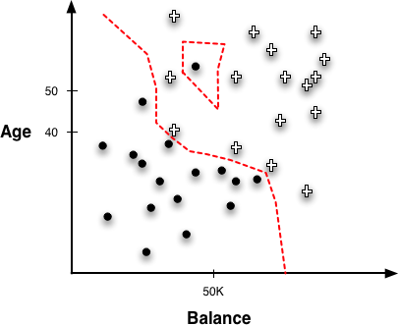
k = 1 Any new point will be classified like the single one closet to it
What’s the problem here?
If a model with k=1 were tested against the same data it was trained on, what would its accuracy be?

Slide 25
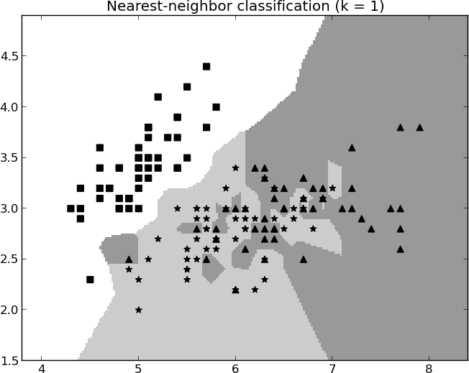
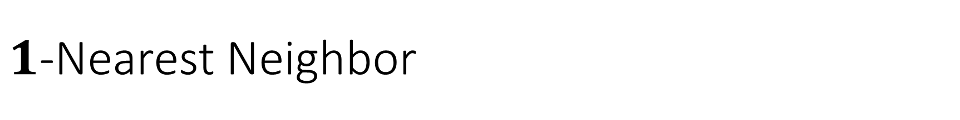
$1$-Nearest Neighbor
Good?

Slide 26
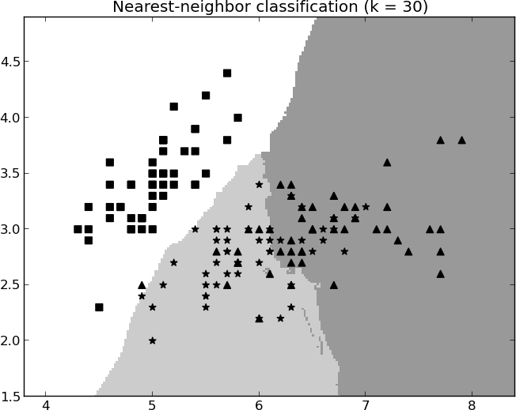
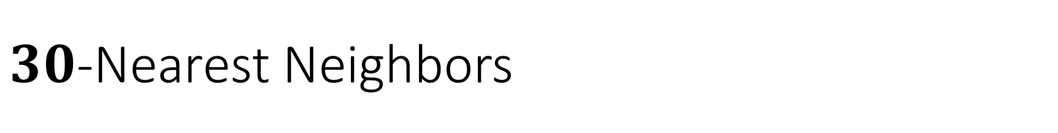
$30$-Nearest Neighbors
Better?

Slide 27
What if k=n?
What would the model predict…
for a classification task?
for class probability?
for a regression?

Slide 28
How might you determine the best k?
Cross-validation, try a bunch of k, find the one that leads to the best score on the holdout data. Then train a final model using that k.

Slide 29
Issues with Nearest-Neighbor Models
Dimensionality and domain knowledge
The more features (dimensions) you have, the more likely it is that insignificant features swamp out the impact of important ones
Use domain knowledge to carefully select features to include
Computational efficiency
Very fast to train, very slow to make a prediction
Slow because for each given X feature vector, entire dataset needs to be scanned to find nearest neighbors.
Easy to “interpret,” but no “knowledge” extracted from the data
“This classification was made because the new data was similar to these three known data points.”
Illegal to use in some scenarios such as loan decisions.

Slide 30
Many figures in this slide deck from Provost, F., & Fawcett, T. (2013). Data science for business: what you need to know about data mining and data-analytic thinking. Sebastopol, Calif.: O'Reilly.

